Slide 1


Slide 2
Students :
Tomer Haina – 315806968
Adir Digmi - 209187038

Slide 3
The main question of the project
Is it possible to identify gender by facial features?
Our goal in this project is to know if its possible to recognize a gender through an image by using facial features with the help of machine learning models and methods that we have learned, moreover, we want to evaluate the results that we are getting from the computer in order to decide whether the results are good enough to determine if its possible to recognize a gender by the images that we analyzed.

Slide 4
Project Breakdown
Step 1: Scraping
crawling.py – Our database contained over 70,000 images that we scraped from shutterstock.com
For each gender and age category we have downloaded more than a 100 pages.
Using our crawler, we ran our code for 4 days from 4 different computers to establish our database.
Step 2: Data
create_df.py – In this part of the project we were required to take our data and store it in a labeled dataframe, which in every row held the details of an image, and the the columns in the dataframe were the distance between two specific points on the face that we recognized in the image (with the help of our model that we will talk about in the next paragraph).
Expanding our data from points into specific distances between points that can be a significant factor to recognize between images of male and female faces.
Step 3: Model
build_model.py - In this step we tried out a myriad of models and we took the one who had the best accuracy.
Step 4 : Interpretation
At this section of the presentation, we will talk about our conclusions from the project, and our feelings about the project.
Step 4 in the next page :

Slide 5

Step 1 : Scraping

Slide 6
How did we create our database ?
At first, we tried to fetch images with BeautifulSoup from ShutterStock since it contains a great amount of categorized images but we were halted because the site had crawling protections, and was loading images dynamically
(only images that show on the front could be scraped), which forced us to use other methods,
the best option that we found was using Selenium.
Our crawler saved images from the website to our local storage only if a face could be recognized in the image, a method which allowed us to work with cleaner data.
We saved every image with a name which allowed us to know the gender of the person.
In order to avoid duplicates our crawler checks whether an image with the exact name was saved before, so it won’t save it again.

Slide 7

Step 2: Data

Slide 8
Exporting the data into dataframe :
After we filled our folder with labeled images, we load each one using openCV and recognized the face in the image using dlib,
In order to recognize specific coordinates on the face we used a face landmarks model with 68 points since it was the most accurate of the other models we found.
We have exported the coordinates for each image to our dataframe, we then normalized each point according to the axes and the height and width of the face.
We assigned an ID for each landmark, each image represented as a row in our dataframe and the columns were location of the points on the face.

Slide 9
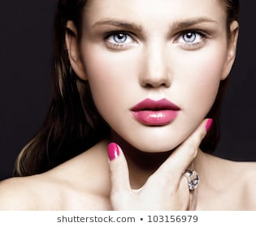
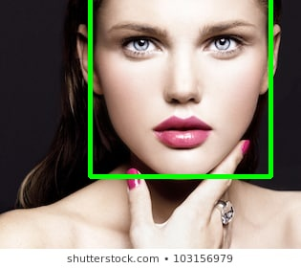
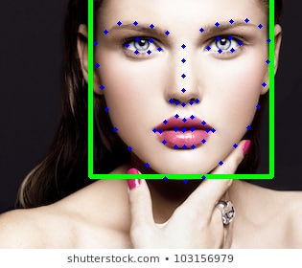
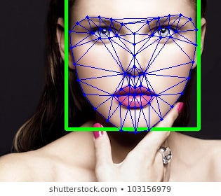
In this slide you can see the process that the image is going through using our face recognition algorithm :
Step 1 :
Step 2 :
Step 3 :
Step 4 :

Slide 10
What did we do with our Dataframe ?
After we had a dataframe with all of the coordinates of the points from the file
That we mentioned earlier called “face landmarks” , we searched for specific
Distances between the points that can give us and the model useful information
so he can recognize gender by image.
Expanding our data from points to Distances :
In this section, we hooked up points to calculate their distances and tried to look for patterns that can distinguish between the genders, we found out various
of distances that can help, we collected a few distances and we made a new dataframe which every column represent the distance between two specific points,
and every row was an image that we got from our crawler.
We looked on the internet for a linear framing method to distinguish faces.
We found an image of sets of points and lines which every line represents a facial feature, eventually we had 175 distances on the face , we sent those distances to our machine learning model so it can learn the differences of the distances between a females and males faces.

Slide 11
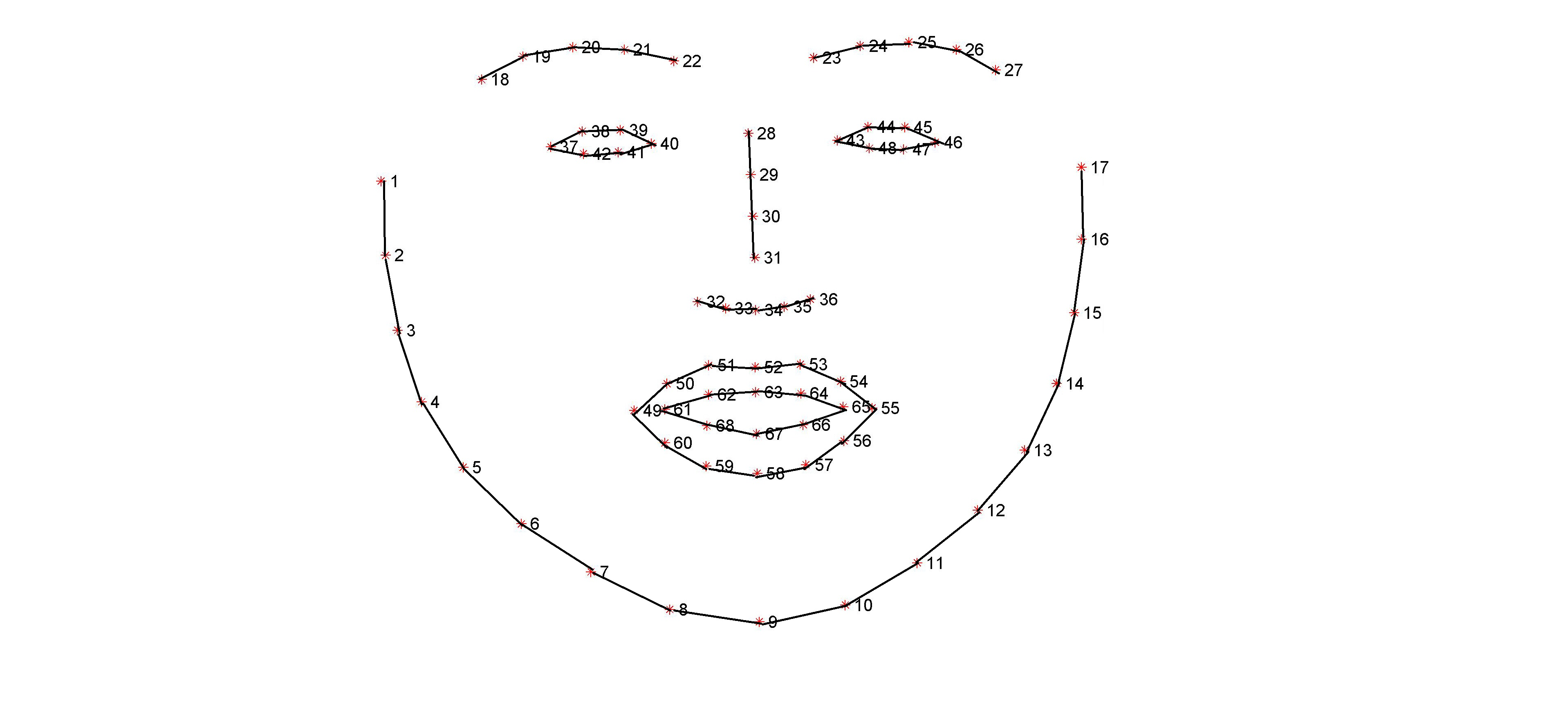
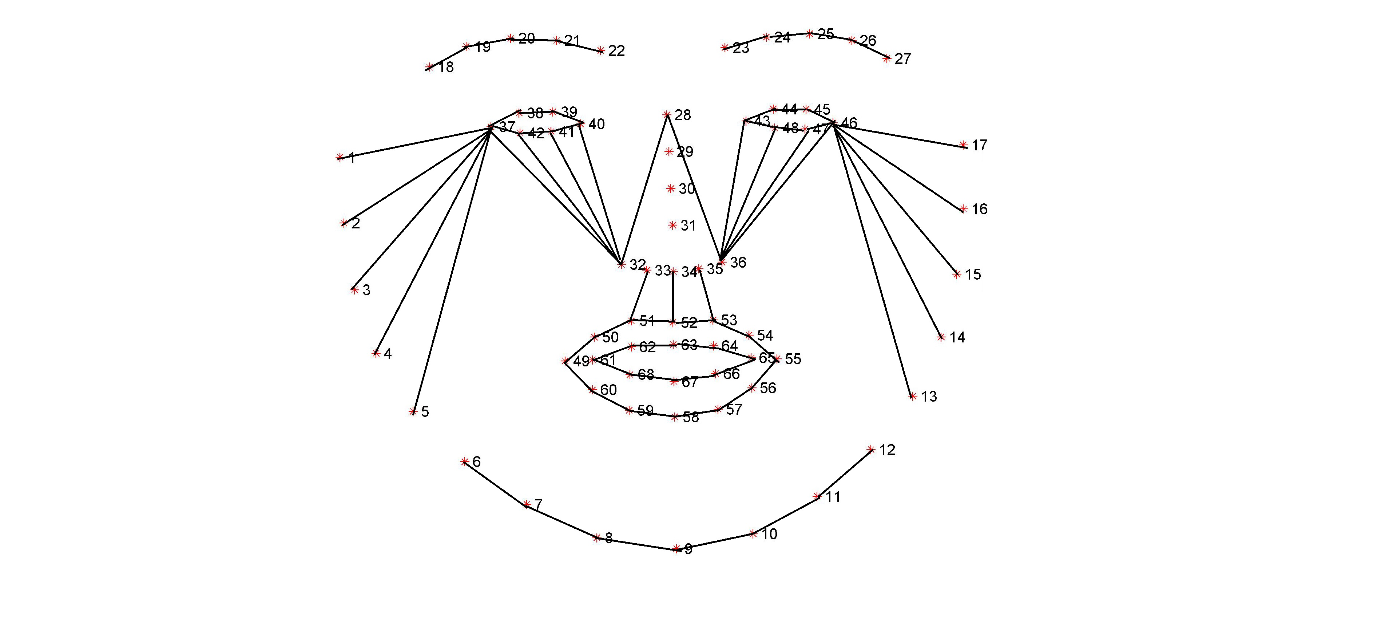
Distances between points :
At the start of the process we tried different distances between points and the results of the model wasn’t accurate enough in our opinion, so we searched the internet and we found an image with all the distances between specific points on the face that we need, when we implement those distances in our model we got better accuracy results than before.
An examples of what we tried at the start :

Slide 12
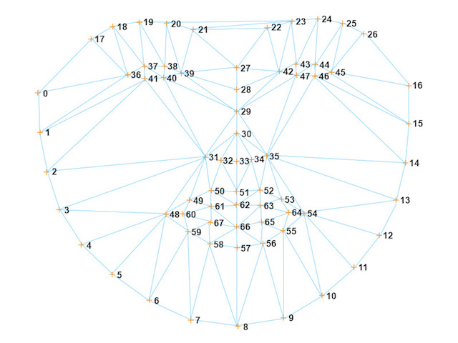
The image of the distances that we found on the internet as we mentioned earlier :
Source : http://redlcv.blogspot.com/2017/12/red-and-dlib-for-face-processing.html

Slide 13
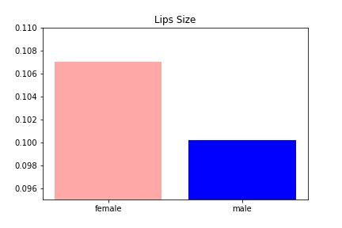
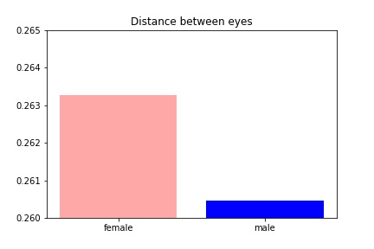
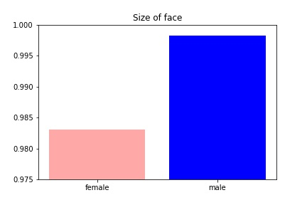
Here we can see the ratio of specific distances between a female face and male face :
In this bar plot we can see that the average of the lips size of females was bigger than the males.
In this bar plot we can see that the average distance between the eyes of the females was bigger than the males.
In this bar plot we can see that the average of the face size of the males was bigger than the females.

Slide 14

Step 3 : Model

Slide 15
Step 3 : Model
In this part of the project we looked for model which will give us the best accuracy score on the data that we have, we started from a few models who didn’t gave us enough accuracy as we expected and we chose to search for another model in order to get higher accuracy score ,eventually we found a model called SVM who gave us the best accuracy score in comparison to the other models, so we decided that the machine learning model that will lead the project will be SVM.

Slide 16
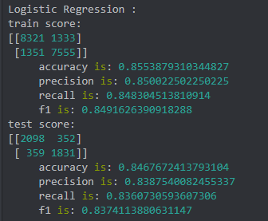
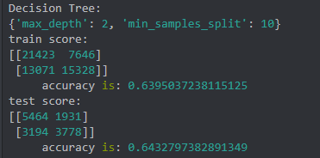
We tried few models on our dataset and we chose the one who gave us the best accuracy score on our data :
Logistic regression :
Decision Tree :

Slide 17
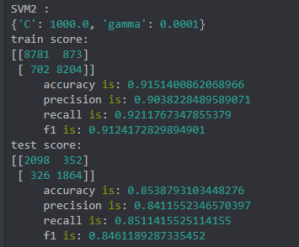
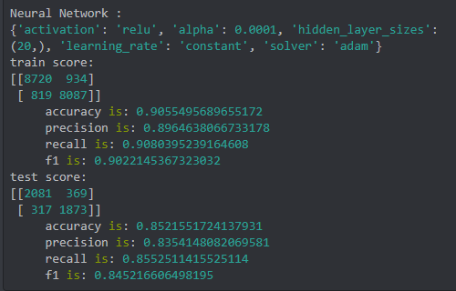
SVM2 :
Neural network :

Slide 18
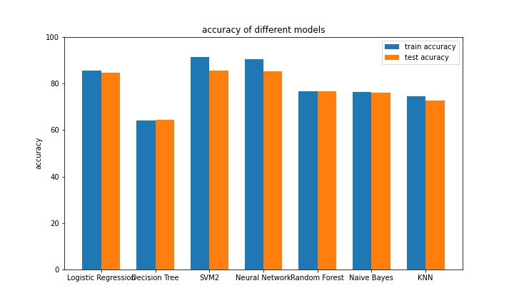
In this slide we can see the accuracy of the train score and the test score for each model that we have tried presented in a bar plot :

Slide 19

Step 4 : Interpretation

Slide 20
Step 4 : interpretation
We found out that it is possible to recognize gender by facial features.
We found that there is a difference in specific facial features between male and female for example the size of the face in males images was bigger than the females ,and the lips size of the females was bigger than the males as we mentioned earlier.
For summary we enjoyed doing that project ,the project was challenging, and we had to learn new things and expand horizons in order to answer the main question of the project.

Slide 21
Thank you for watching

